Slide 1
“Look how they massacred my boy”
What we plan to do to this
poor man’s Discord bot
Tod Jones
Dakota Methvin
Vince Seely

Slide 2
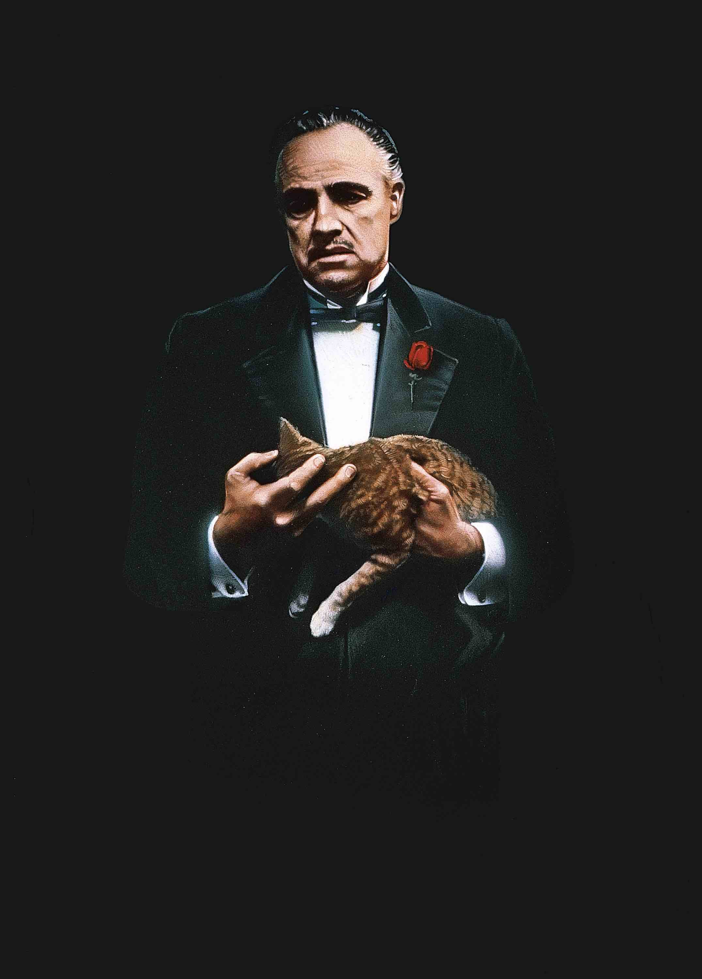
Background
Catch-all Discord bot
First committed to GitHub in August 2017
More than 1800 commits (averaging 8/wk)
Custom database/exception handling solutions
11+ major games/features added
Code messier than a Mafia crime scene

Slide 3
Possible Tasks - Corrective
Dependencies on .NET Standard have the possibilities to fail on non-Windows platforms.
Locally-implemented database has no access control specifications.

Slide 4
Possible Tasks - Adaptive
Isolating the project in a Docker container would provide additional hosting options, would increase deployment options (cloud services instead of local VMs), and would allow in-place upgrades at an accelerated pace.
New GDPR compliance standards are likely unmet, and substantial work would be required to bring the data-collection aspects of this project up to legal specification for deployment in the EU.

Slide 5
Possible Tasks – Adaptive (cont.)
The current local database solution relies on npgsql (an external Clang-to-SQL solution). Another SQL-interaction option (esp. one provided by .NET Core) could reduce complexity and provide more reliable execution.

Slide 6
Possible Tasks – Perfective
Add access to the Ubisoft-provided Rainbow Six Siege player statistics API and appropriate command functionality in the Discord application.
Add Right-to-be-Forgotten options as required by GDPR. See potential task AD2 for more information.
Migrating the database from a local solution to a server-based solution could increase performance (by accessing more optimized services) at the potentially-lower cost of latency.

Slide 7
Possible Tasks – Preventive
Texas Hold ‘Em and Giphy.NET extensions are running on .NET Standard while the rest of the project utilizes .NET Core. Standardizing this dependency could result in cleaner, more maintainable code.
Certain core files contain long methods, excessive loops, and high complexity paths. These could be refactored to produce cleaner, more reliable code.

Slide 8
Possible Tasks – Preventive (cont.)
The project’s testing suite is insufficient. Adding unit and integration tests would streamline refactoring and feature additions.

Slide 9
Source Files

